Slide 1
Linear Regression using Python
Notes:
Notes:
Do: <Explain what the facilitator needs to do.>.
Tell: <Summarize what the facilitator needs to say.>
Ask: <List the question/s the facilitator should ask the participants.>
Expected Responses: <List the responses facilitator might get from the participants on the asked question/s.>
Show: <List what the facilitator needs to show.>

Slide 2
CONTENTS
Over view to Simple and multi Linear Regression
Build simple and multi linear regression models
Splitting the data sets training and validation
Model Diagonostics

Slide 3
Simple Linear Regression
Relationship between one dependent variable and explanatory variable(s)
Supervised Learning algorithms in predictive analytics
Requires knowledge of both outcome and feature variables in the training data set
Examples
Total cost of patient for a treatment with the body weight of the patient
Healthcare cost and ageing for insurance
Revenue generated from products from promotion
For e commerce : relation between revenue and features such as no of clicks, no of items on sale, avg discount price , no of customer visit
Bank issuing loan on the basis of feature such as bank balance, marital status, un employment rate etc

Slide 4
Steps in simple Linear Regression
Step-1 : Collect/Extract data
Step-2 : Preprocess data : ensure quality to data to fit to models
Imputation to deal missing values
Descriptive statistics and visualization to find the existence of outliers and variability in the data set
Feature engineering- Deriving new variables from the existence variables
categorical variables to dummy variables
Step- 3 Dividing Data to training and validation sets
Training- 70-80%, remaining validation set
Random sampling procedures
Step-4 Data exploration/ Descriptive statistics
Understand the variability /outliers/relationships
Step- 5 Build the model
Using training data set to estimate regression parameters
OLS method used to estimate regression parameters

Slide 5
Steps in simple Linear Regression
Step-6 : Model Diagnostics
Validate model assumptions, to check violation of assumptions
Step-7 : Measure model accuracy
Check over fitting using validation; consistency of model in the training and validation data set
Step- 8 Model Deployment
Form of Actionable items and business rules that can be used by the organization

Slide 6
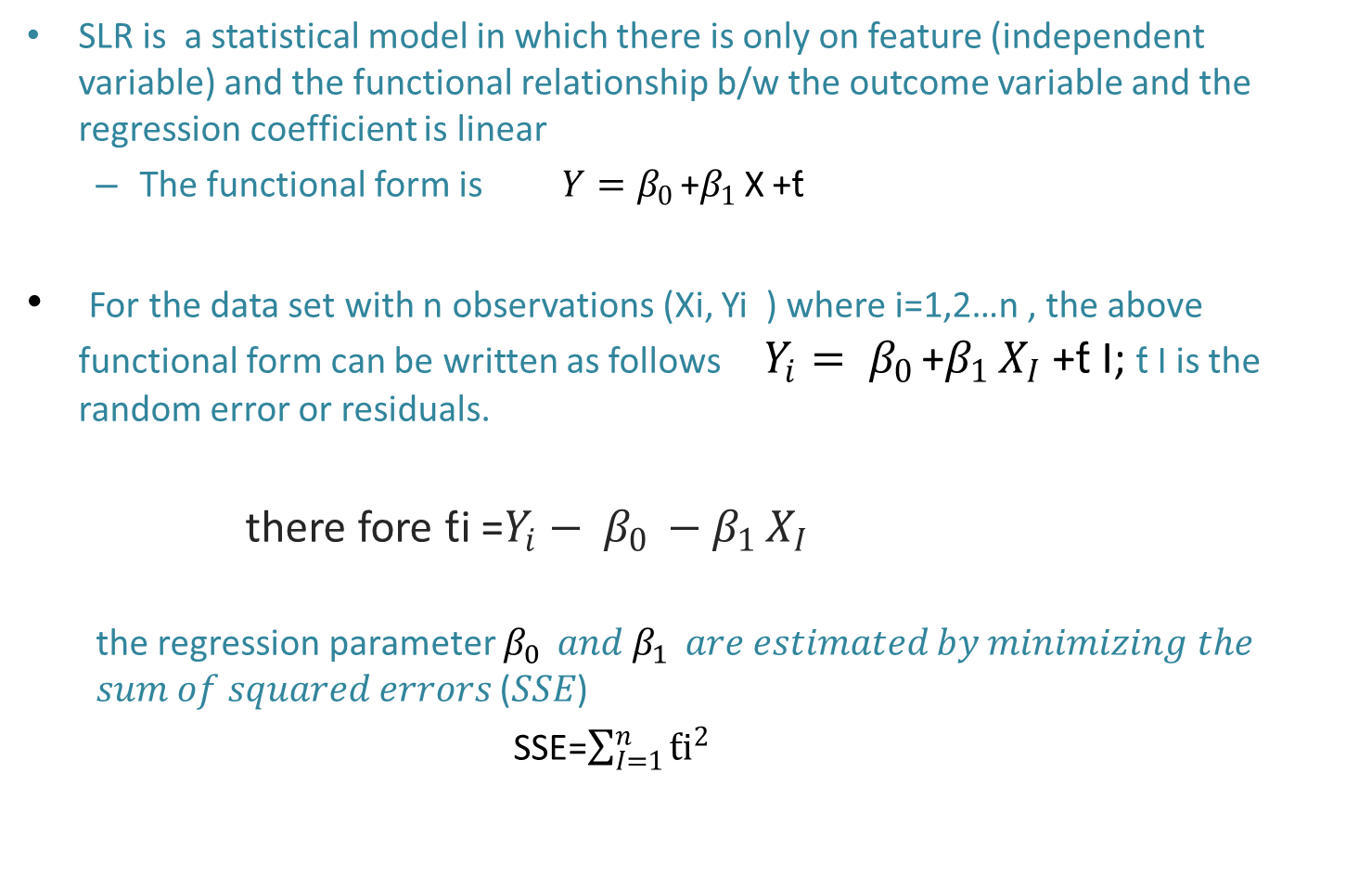
Principle of Linear Regression
SLR is a statistical model in which there is only on feature (independent variable) and the functional relationship b/w the outcome variable and the regression coefficient is linear
The functional form is $Y=β_{0 }$+$β_{1 }$X +ƭ
For the data set with n observations (Xi, Yi ) where i=1,2…n , the above functional form can be written as follows $Y_{i}= β_{0 }$+$β_{1 }X_{I}$ +ƭ I; ƭ I is the random error or residuals.
there fore ƭi =$Y_{i}− β_{0 }−β_{1 }X_{I}$
the regression parameter $β_{0 }$𝑎𝑛𝑑 $β_{1 }$𝑎𝑟𝑒 𝑒𝑠𝑡𝑖𝑚𝑎𝑡𝑒𝑑 𝑏𝑦 𝑚𝑖𝑛𝑖𝑚𝑖𝑧𝑖𝑛𝑔 𝑡ℎ𝑒 𝑠𝑢𝑚 𝑜𝑓 𝑠𝑞𝑢𝑎𝑟𝑒𝑑 𝑒𝑟𝑟𝑜𝑟𝑠 (𝑆𝑆𝐸)
SSE=$\sum_{I=1}^{n}{{ƭi}^{2}}$

Slide 7
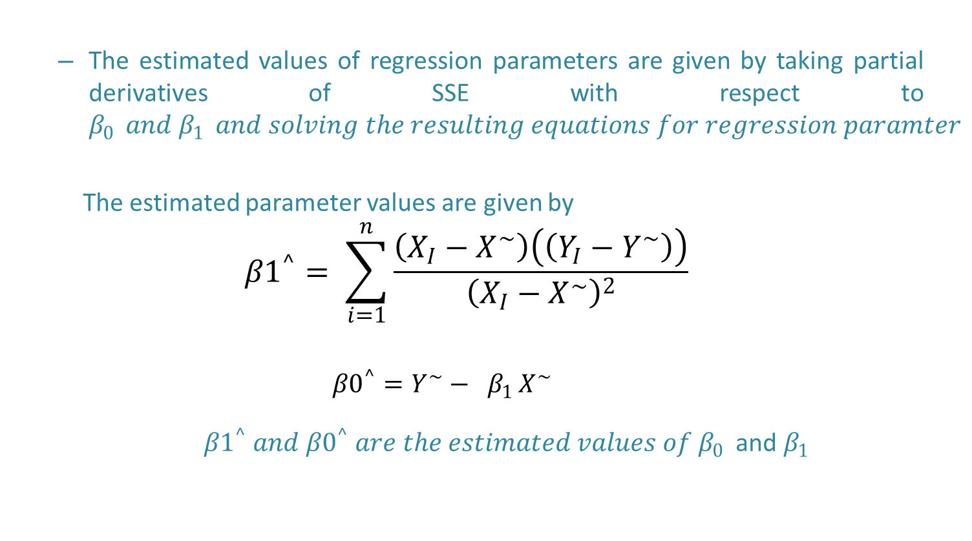
Principle of Linear Regression
The estimated values of regression parameters are given by taking partial derivatives of SSE with respect to $β_{0 } and β_{1 } and solving the resulting equations for regression paramter$
The estimated parameter values are given by
$${β1}^{^}= \sum_{i=1}^{n}{\frac{\left(X_{I}−X^{\sim }\right)\left(\left(Y_{I}−Y^{\sim }\right)\right)}{{\left(X_{I}−X^{\sim }\right)}^{2}}}$$
$${β0}^{^}=Y^{\sim }− β_{1 }X^{\sim }$$
${β1}^{^} and {β0}^{^} are the estimated values of β_{0 }$ and $β_{1 }$

Slide 8

Assumptions of Linear Regression
Errors or residuals are $ƭi$ are assumed to follow a normal distribution
The variance of error is constant, is constant for various values of independent variable X (homoscedasticity)
The error and independent variable are uncorrelated
The functional relationship b/w outcome and feature variable is correctly defined

Slide 9
Linear Regression- Example
The data MBA salary.csv contains the salary of 50 graduating MBA students of a business school in 2016 and their % marks in grade 10. Develop an SLR Model to understand and predict salary based on the % marks in grade 10.
Steps
Import pandas & numpy libraries
Load data set into df
Identify the features X & Y for building the model
Splitting data set to training and validation
Import stats model library and fit the model using OLS () method
Print model summary and conduct model diagonostics

Slide 10
Linear Regression- Example
## Creating Feature Set(X) and Outcome Variable(Y)
## stats model library is used in python for building statistic model ; OLS API available in statsmodels.api is used for estimation of parameters of SLR model
## Splitting the dataset into training and validation sets- train_test_split from sklearn.module _selection module
Train size will be from 0 to 1
Randomly sampled
Random_state parameter fix seed value which sample to go to training set

Slide 11
Model Diagonostics
Validate the regression model to ensure its validity and goodness fit before it can be used for practical applications
Coefficient of determination( R squared)
Hypothesis test for regression coefficient
Analysis of variance- FOR MLR
Residual anlysis- validate model assumptions
Outlier analysis

Slide 12
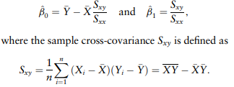




Coefficient of determination( R squared)
R-squared (R2 ) is a statistic that explains the amount of variance accounted for in the relationship between two (or more) variables
Given paired variables, a linear model that explains the relationship between the variables is given by
Estimated model denote as
Sum of squared error / residual is
Total sum of squares (SST) is the measure of total variation in the Y variable and is defined as
where Y is the sample mean of Y variables, that is,

Slide 13

Coefficient of determination( R squared)
The ratio SSR/SST = (SST − SSE)/SST measures the proportion of variability explained by the model. The coefficient of determination (R2 ) is defined as the ratio
Note that the coefficient of determination ranges between 0 and 1
R2 = 1 indicates that the model exactly explains the variability in Y, and hence the model must pass through every measurement
R2 = 0 indicates that the model does not explain any variability in Y.
R2 value larger than .5 is usually considered a significant relationship.

Slide 14


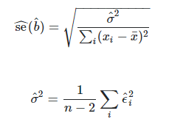
Hypothesis test for the regression coefficient
β1 captures the existence of linear relationship b/w outcome variable and feature. β1=0 means no statistically significant relationship b/w two variables.
It can be proved that the sampling distribution β1 is at t-distribution
The hypothesis is a two tailed test with (n-2) DOF ;ie 2 DOF are lost due to the estimation of two regression parameter β0 and β1
The null & alternate hypothesis are
H₀: β1=0
H_{A}: β1≠ 0
The corresponding test static is given by
Where the standard error of estimate of the regression coefficient is given by

Slide 15
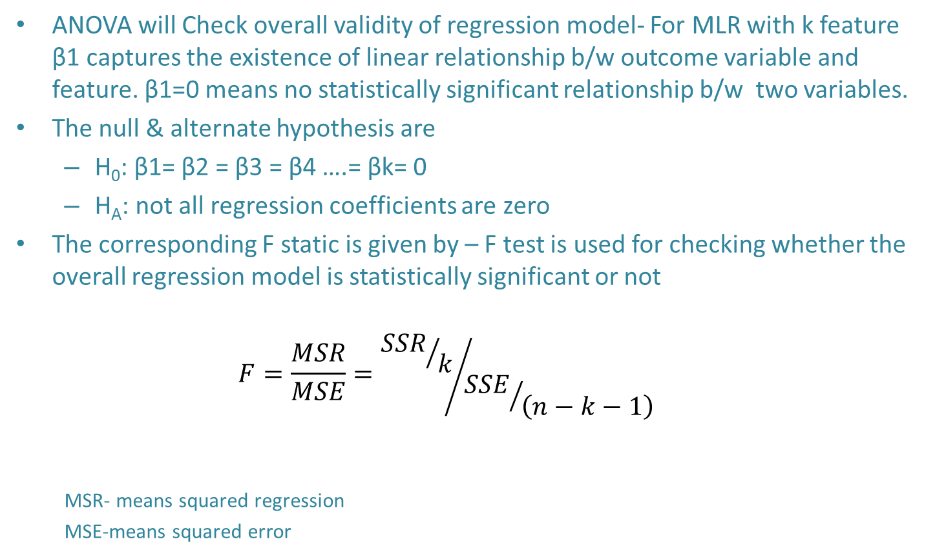
ANOVA in regression analysis
ANOVA will Check overall validity of regression model- For MLR with k feature β1 captures the existence of linear relationship b/w outcome variable and feature. β1=0 means no statistically significant relationship b/w two variables.
The null & alternate hypothesis are
H₀: β1= β2 = β3 = β4 ….= βk= 0
H_{A}: not all regression coefficients are zero
The corresponding F static is given by – F test is used for checking whether the overall regression model is statistically significant or not
$$F=\frac{MSR}{MSE}={{SSR}/k}/{{SSE}/{\left(n−k−1\right)}}$$
MSR- means squared regression
MSE-means squared error

Slide 16
Residual analysis
Residual error are the difference b/w actual & predicted value of outcome variable (Yi-Y~)
This is important to check whether the assumptions of regression models have been satisfied
It is performed to check the following
The residual are normally distributed
Variance of residual is constant (homoscedasticity)
The functional form of regression is correctly specified
There are no outliers

Slide 17
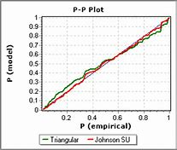
Normal distribution residual
In statistics, a P–P plot (probability–probability plot or percent–percent plot or P value plot) is a probability plot for assessing how closely two data sets agree, which plots the two cumulative distribution functions against each other. P-P plots are vastly used to evaluate the skewness of a distribution.
Check whether the distribution of residuals matches with that of a normal distribution

Slide 18
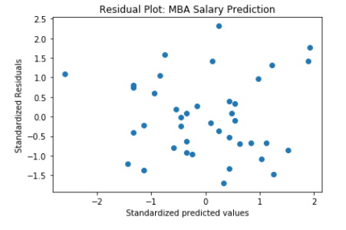
Test of Homoscedasticity
An imp assumption of LR model is that residual have constant variance (Homoscedasticity)
It can be obtained by drawing residual plot, which is plot b/w standardized residual value ad standardized predicted value
If there is a heteroscedasticity, a funnel type shape in the residual plot can be expected

Slide 19
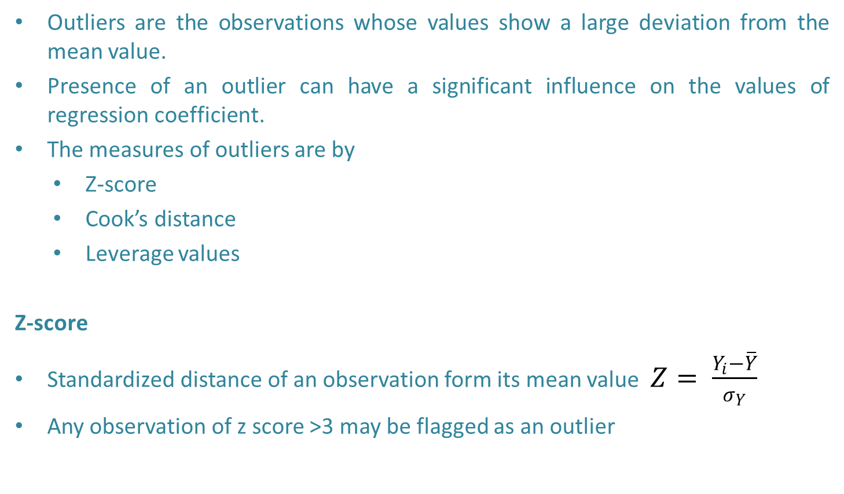
Outlier analysis
Outliers are the observations whose values show a large deviation from the mean value.
Presence of an outlier can have a significant influence on the values of regression coefficient.
The measures of outliers are by
Z-score
Cook’s distance
Leverage values
Z-score
Standardized distance of an observation form its mean value $Z= \frac{Y_{i}−\overline{Y}}{σ_{Y}}$
Any observation of z score >3 may be flagged as an outlier

Slide 20
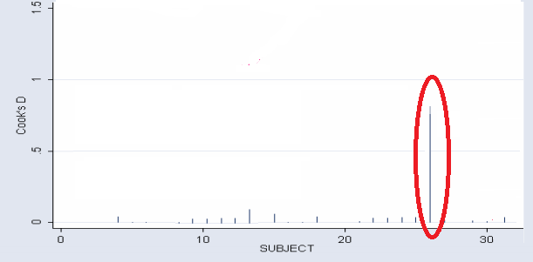
Outlier analysis
Cook’s Distance
It measures how much the predicted value of the dependant variable changes for all observation in the sample when a particular observation is excluded from the sample for the estimation of regression parameters.
A cook’s distance values of >1 indicates that highly influential observation

Slide 21
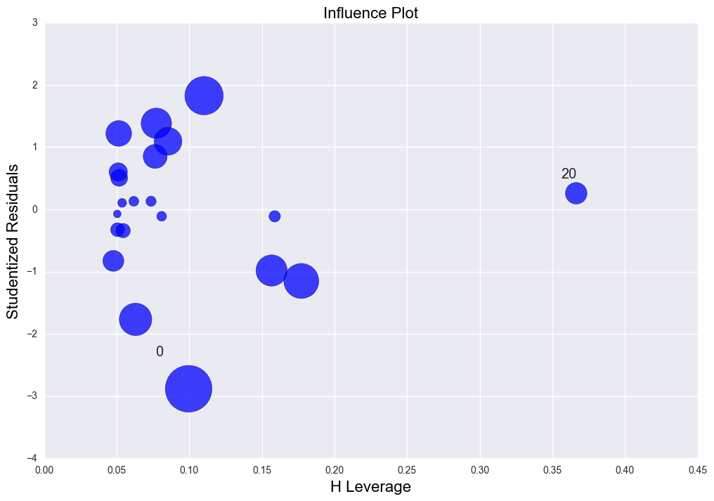
Outlier analysis
Leverage values
Leverage value of an observation measures the influence of that observation on the overall fit of the regression function and is related to the Mahalanobis distance
Leverage value of > (3K+1)/n treated as high influenced observation; where k is the no of feature and n is the sample size
The observation with high leverage value and high residual can be removed from the training data set

Slide 22
SLR Measurement parematers……….
Adj R squared
Adjusted R2 also indicates how well terms fit a curve or line, but adjusts for the number of terms in a model
The adjusted R2 tells the percentage of variation explained by only the independent variables that actually affect the dependent variable.
The more useless variables to a model, adjusted r-squared will decrease, more useful variables, adjusted r-squared will increase; Adjusted R2 will always be less than or equal to R2
F static & F Value
An F statistic is a value when run an ANOVA test or a regression analysis to find out if the means between two populations are significantly different. It’s similar to a T statistic from a T-Test; A-T test will tell a single variable is statistically significant and an F test will tell group of variables are jointly significant.
Use the F statistic when deciding to support or reject the null hypothesis using F value and F-static; calculated F value in a test is larger than your F statistic, you can reject the null hypothesis.

Slide 23

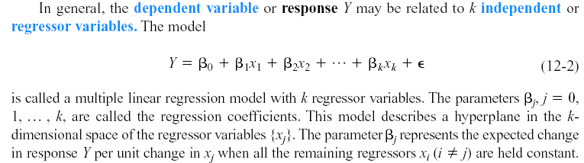
Multi Linear Regression
A regression model that contains more than one regressor variable is called a multiple regression model
For example, suppose that the effective life of a cutting tool depends on the cutting speed and the tool angle. A possible multiple regression model could be
where
Y – tool life
x1 – cutting speed
x2 – tool angle

Slide 24
Multi Linear Regression-Assumptions
Assumptions
The regression model is linear in regression parameters (β values)
The residual follow a normal distribution and mean (*expected value) of the residual is zero.
In time series data , residuals are assumed to un correlated
Homoscedasticity- variance of the residuals is constant
Multi collinearity ( no high correlation between independent variables)
## Partial regression coefficients are estimated my minimizing the SSE (sum of squared error).

Slide 25
Multi Linear Regression- Hands-On : IPL Auction analysis
Data set and information
The IPL is professional cricket t20 league championship started in India in 2008. It was initiated by BCCI with 8 franchises comprising players across the world. The first IPL auction was held in 2008 for ownership of the teams for 10 years, with base price of USD 50 Billion. The performance of the players could be measured many ways. The data set consist of performance 0f 130 players measured through various performance measure metrics such as batting , bowling etc Science of describing the past data
Data set name: IPL IMB381IPL2013.CSV
Plans: Build model to understand what features of players are influencing their SOLD PRICE or predict the player’s auction price in future.
Note- all the columns are not consider as features eg: S.N,
We build mode using players statistics- remove base price

Slide 26
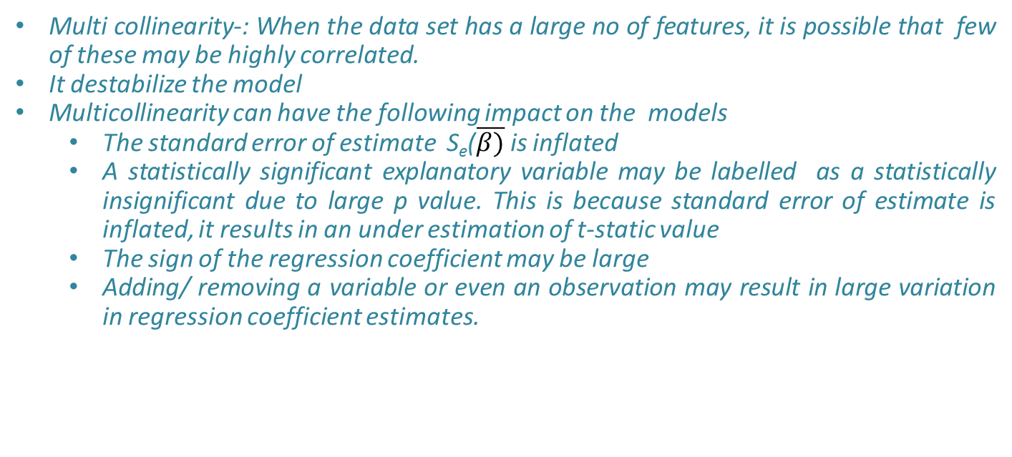
Multi collinearity
Multi collinearity-: When the data set has a large no of features, it is possible that few of these may be highly correlated.
It destabilize the model
Multicollinearity can have the following impact on the models
The standard error of estimate S_{e}($\overline{β)}$is inflated
A statistically significant explanatory variable may be labelled as a statistically insignificant due to large p value. This is because standard error of estimate is inflated, it results in an under estimation of t-static value
The sign of the regression coefficient may be large
Adding/ removing a variable or even an observation may result in large variation in regression coefficient estimates.

Slide 27
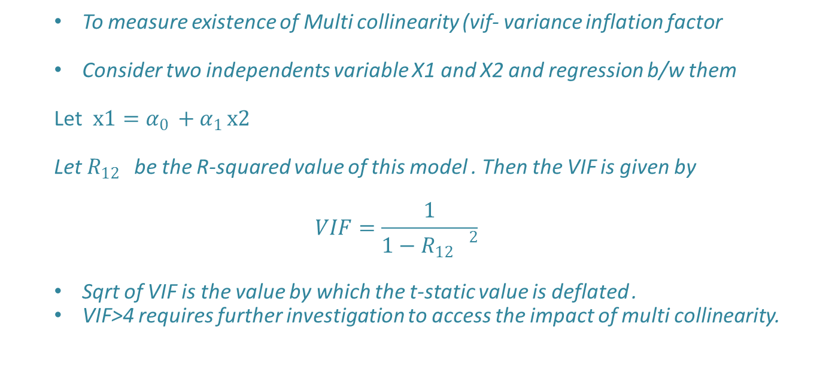
VIF : Measure of Multi collinearity
To measure existence of Multi collinearity (vif- variance inflation factor
Consider two independents variable X1 and X2 and regression b/w them
Let $x1=α_{0 }+α_{1 }x2$
Let $R_{12 }$be the R-squared value of this model . Then the VIF is given by
$$VIF=\frac{1}{1−{R_{12 }}^{2}}$$
Sqrt of VIF is the value by which the t-static value is deflated .
VIF>4 requires further investigation to access the impact of multi collinearity.

